Slide 1
Abraham Lincoln and Theodore Roosevelt
By Arta and Mohammad

Slide 2
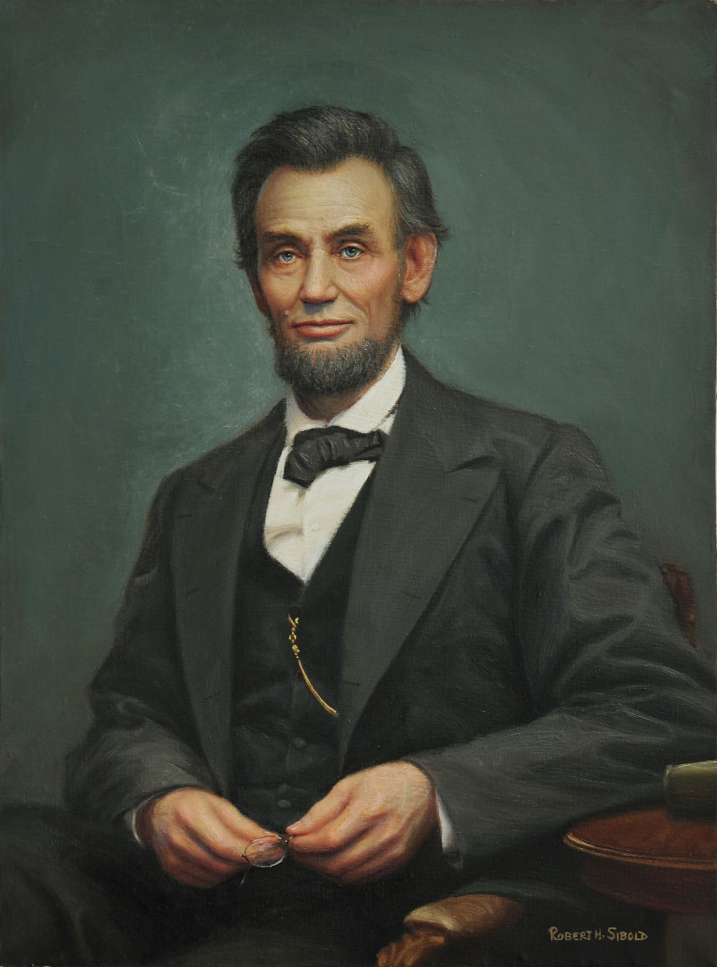
Abraham Lincoln:
Abraham Lincoln was an American politician. He was the 16th President of the United States. He was president from 1861 to 1865, during the American Civil War. Just five days after most of the Confederate forces had surrendered and the war was ending, John Wilkes Booth assassinated Lincoln. Lincoln was the first president of the United States to be assassinated. Lincoln has been remembered as the "Great Emancipator" because he worked to end slavery in the United States.
(February 12, 1809 – April 15, 1865)

Slide 3
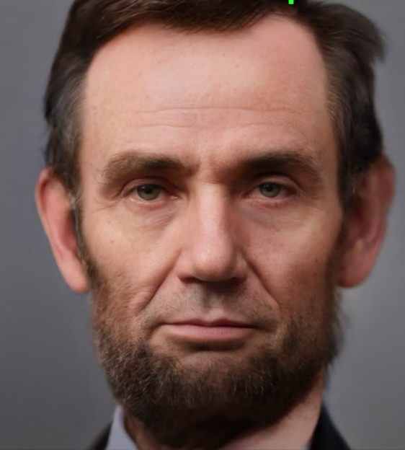
Abraham Lincoln was born on February 12, 1809, in Hodgenville, Kentucky, United States. His parents were Thomas Lincoln and Nancy Hanks. His family was very poor. Abraham had one brother and one sister. His brother died in childhood. They grew up in a small log cabin, with just one room inside. Although slavery was legal in Kentucky at that time, Lincoln's father, who was a religious Baptist, refused to own any slaves.

Slide 4
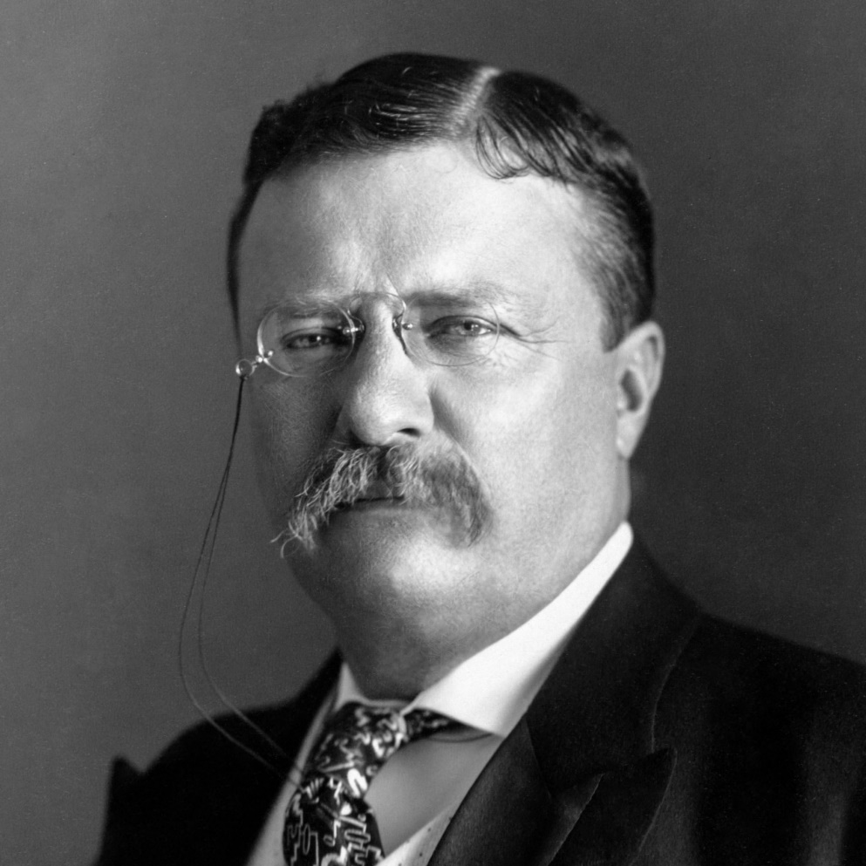
Theodore Roosevelt:
Theodore "Teddy" Roosevelt, Jr. was the 26th president of the United States. He was born in New York.
After spending time in North Dakota, Roosevelt was elected into the New York State Legislature, and served, as a Civil Service Commissioner and New York City police commissioner. In 1897, he was appointed Assistant Secretary of the Navy, but gave up on that to fight in the Spanish American War. became President of the United States.
(October 27, 1858–January 6, 1919),

Slide 5
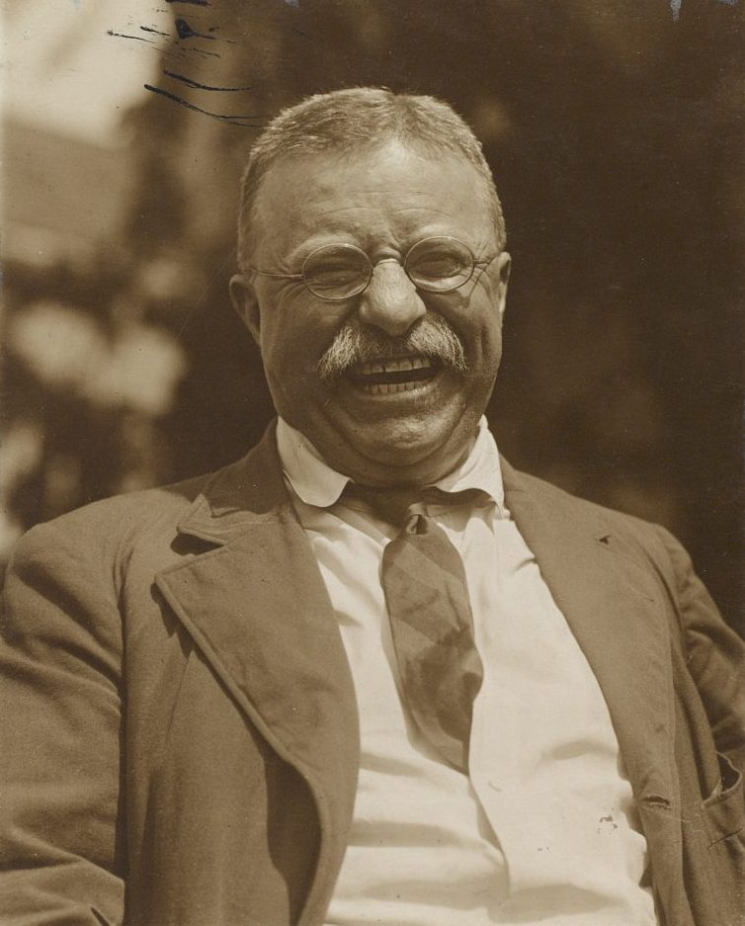
For his actions during the war, Roosevelt was recommended for the Medal of Honor.
In 2001, Theodore Roosevelt became the first President to receive the Medal of Honor.
As President, Roosevelt worked to make the U.S. a world power, one of the most powerful countries in the world. Before, it had been the richest country in the world, but not a significant military power.

Slide 6
The End

